Slide 1

Malware analysis using Machine Learning
Rakshit Parashar 16CSU285
Raunaq Raj Singh 16CSU290

Slide 2
INTRODUCTION
"Malware" is an abbreviation for "malicious software", it is used as a single term to refer to Viruses, Trojans, Worms, etc. These programs have a variety of features, such as stealing, encrypting or deleting sensitive data, modifying or hijacking basic computer functions, and monitoring computer activity.
Types of Malware
Computer virus
E-Mail worms
Instant messaging worms
Internet worms
IRC worms
File-sharing files
Ransomware

Slide 3
Malware Analysis Techniques
Static analysis
Dynamic analysis
Hybrid analysis
Malware Detection Techniques
Signature detection
Behaviour Detection
Feature detection

Slide 4
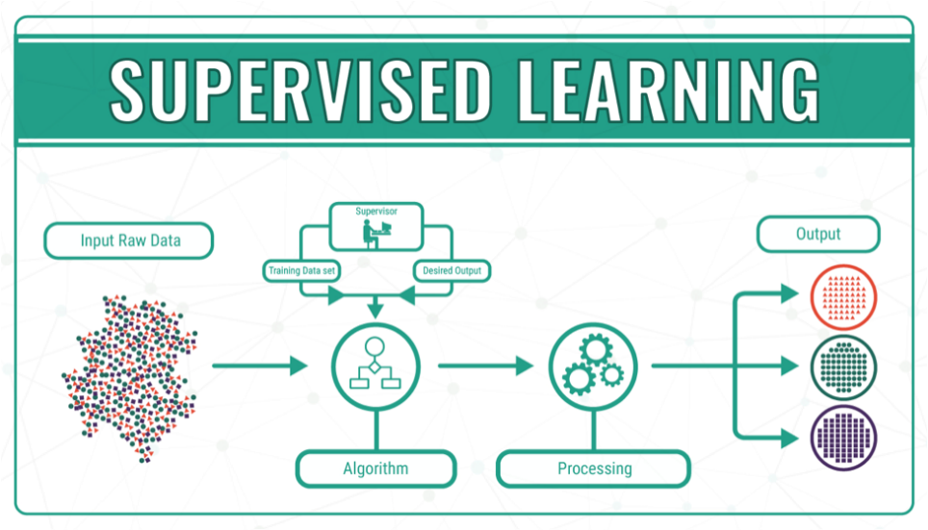
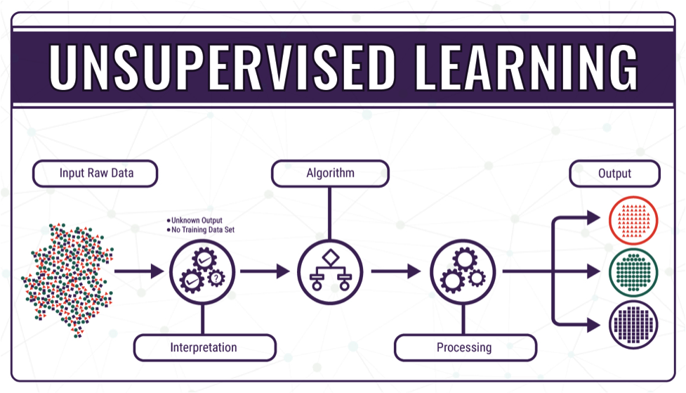
Machine Learning
Machine Learning is a category of algorithms that allow software applications to predict much better results without being specifically programmed. The basic premise of machine learning is to build algorithms that receive input data and use statistical analysis to predict output data while output data is updated like many input data become valid.
Machine learning algorithms are categorized as both supervised and unsupervised.

Slide 5
Algorithms used in this Project
Random Forest
ADA boost
Gradient boosting
Decision Tree
Naïve Bayes

Slide 6
Random Forest
An effective alternative is to use trees with fixed structures and random features . Tree collections are called forests, and classifiers built in so-called random forests. The random water formation algorithm requires three arguments: the data, a desired depth of the decision trees, and a number K of the total decision trees to be built, i. The algorithm generates each of the K trees. independent, which makes it very easy to parallelize. For each tree, build a complete binary tree. The characteristics used for the branches of this tree are selected randomly, usually with replacement, which means that the same characteristic can occur more than 20 times, even in a single branch. a. the leaves of this tree, where predictions are made, are completed based on training data. The last step is the only point at which the training data is used.
The resulting classifier is just a K-lot vote, and random trees. The most amazing thing about this approach is that it actually works remarkably well. They tend to work best when all the features are at least, well, relevant, because the number of features selected for a particular tree is small. One intuitive reason that it works well is the following. Some trees will query unnecessary features. These trees will essentially make random predictions. But some of the trees will happen to question good characteristics and make good predictions (because the leaves are estimated based on training data).

Slide 7
ADA boost
Ada-boost or Adaptive Boosting is one of ensemble boosting classifier proposed by Yoav Freund and Robert Schapire in 1996. It combines multiple classifiers to increase the accuracy of classifiers. AdaBoost is an iterative ensemble method. AdaBoost classifier builds a strong classifier by combining multiple poorly performing classifiers so that you will get high accuracy strong classifier. The basic concept behind Adaboost is to set the weights of classifiers and training the data sample in each iteration such that it ensures the accurate predictions of unusual observations. Any machine learning algorithm can be used as base classifier if it accepts weights on the training set.
The classifier should be trained interactively on various weighed training examples.In each iteration, it tries to provide an excellent fit for these examples by minimizing training error.Initially, Adaboost selects a training subset randomly.It iteratively trains the AdaBoost machine learning model by selecting the training set based on the accurate prediction of the last training.It assigns the higher weight to wrong classified observations so that in the next iteration these observations will get the high probability for classification.Also,
It assigns the weight to the trained classifier in each iteration according to the accuracy of the classifier. The more accurate classifier will get high weight.This process iterate until the complete training data fits without any error or until reached to the specified maximum number of estimators.To classify, perform a "vote" across all of the learning algorithms you built.

Slide 8
Gradient boosting
The idea behind "gradient boosting" is to take a weak hypothesis or weak learning algorithm and make a series of tweaks to it that will improve the strength of the hypothesis/learner. This type of Hypothesis Boosting is based on the idea of Probability Approximately Correct Learning (PAC).This PAC learning method investigates machine learning problems to interpret how complex they are, and a similar method is applied to Hypothesis Boosting.
In hypothesis boosting, you look at all the observations that the machine learning algorithm is trained on, and you leave only the observations that the machine learning method successfully classified behind, stripping out the other observations. A new weak learner is created and tested on the set of data that was poorly classified, and then just the examples that were successfully classified are kept.
The Gradient Boosting Classifier depends on a loss function. A custom loss function can be used, and many standardized loss functions are supported by gradient boosting classifiers, but the loss function has to be differentiable .Classification algorithms frequently use logarithmic loss, while regression algorithms can use squared errors. Gradient boosting systems don't have to derive a new loss function every time the boosting algorithm is added, rather any differentiable loss function can be applied to the system.
Gradient boosting systems have two other necessary parts: a weak learner and an additive component. Gradient boosting systems use decision trees as their weak learners. Regression trees are used for the weak learners, and these regression trees output real values. Because the outputs are real values, as new learners are added into the model the output of the regression trees can be added together to correct for errors in the predictions.

Slide 9
Decision Tree
A decision tree is a flowchart-like tree structure where an internal node represents feature(or attribute), the branch represents a decision rule, and each leaf node represents the outcome. The topmost node in a decision tree is known as the root node. It learns to partition on the basis of the attribute value. It partitions the tree in recursively manner call recursive partitioning. This flowchart-like structure helps you in decision making. It's visualization like a flowchart diagram which easily mimics the human level thinking. That is why decision trees are easy to understand and interpret.
Decision Tree is a white box type of ML algorithm. It shares internal decision-making logic, which is not available in the black box type of algorithms such as Neural Network. Its training time is faster compared to the neural network algorithm. The time complexity of decision trees is a function of the number of records and number of attributes in the given data. The decision tree is a distribution-free or non-parametric method, which does not depend upon probability distribution assumptions. Decision trees can handle high dimensional data with good accuracy.

Slide 10
Naïve bayes
Naive Bayes is a statistical classification technique based on Bayes Theorem. It is one of the simplest supervised learning algorithms. Naive Bayes classifier is the fast, accurate and reliable algorithm. Naive Bayes classifiers have high accuracy and speed on large datasets.
Naive Bayes classifier assumes that the effect of a particular feature in a class is independent of other features. For example, a loan applicant is desirable or not depending on his/her income, previous loan and transaction history, age, and location. Even if these features are interdependent, these features are still considered independently. This assumption simplifies computation, and that's why it is considered as naive. This assumption is called class conditional independence.

Slide 11
Functional Partitioning of Project
Overall Project is partitioned into various phases:
a) Phase 1: Downloading 1,38,000+ dataset of malicious and legitimate PE files
b) Phase 2: Performing Malware analysis and classification, choosing best out of 5 ML algos and feature classification
c) Phase 3: Deploying Full stack Flask framework using HTML,Bootstrap,CSS,Javascript for static analysis

Slide 12
Understanding PE files
PE stands for portable executable. It is the native executable format of Win32. Its specification is derived somewhat from the Unix COFF (common object file format). The format information of PE file is illustrated in Figure 8. It is basically a data structure that encapsulates the information necessary for the Windows OS loader to manage the wrapped executable code. A PE file consists of a PE file header and a section table (section headers) followed by the sections’ data. The PE file header consists of a MS DOS header, the PE signature, the image file header, and an optional header. The file headers are followed immediately by section headers. Section header provides information about its associated section, including location, length, and characteristics. Section is the basic unit of code or data within a PE or COFF file. Different functional areas, such as code and data areas, are separated logically into sections.

Slide 13
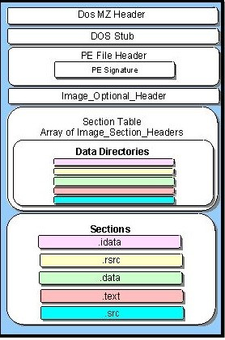

Slide 14
EXPERIMENT
Dataset
Dataset is divided into malware and benign software. We should obtain enough representative training dataset in actual antivirus software. Because we just verify the feasibility of our method, we collected 41324 types of benign software and 96724 types of malware. All are in the Windows PE format. We obtained benign software from Windows folder and Program Files folder and used commercial software to verify that each executable was indeed benign. We obtained malware from the website VirusShare.
Feature Extraction
There are many format features in PE files, but most of those features are not helpful in distinguishing malware and benign software. Based on our empirical studies and in-depth analysis of the format features of the PE files, we extracted 54 features that have the potential to distinguish between benign software and malware, from given PE files.

Slide 15
DOS Header
This field is used to identify an MS-DOS-compatible file type. All MS-DOS-compatible executable files set this value to 0x54AD, which represents the ASCII characters MZ. MS-DOS headers are sometimes referred to as MZ headers for this reason. It starts at offset 0 (this can be view with a hex editor).
DOS Stub
The DOS stub usually just prints a string, something like the message, “This program cannot be run in DOS mode.” It can be a full-blown DOS program. When building applications on Windows, the linker sends instruction to a binary called winstub.exe to the executable file. This file is kept in the address 0x3c, which is offset to the next PE header section.

Slide 16
PE File Header
Like other executable files, a PE file has a collection of fields that defines what the rest of file looks like. The header contains info such as the location and size of code, as we discussed earlier. The first few hundred bytes of the typical PE file are taken up by the MS-DOS stub. The PE file is located by indexing the e_ifanew of the MS DOS header. The e_ifanew simply gives the offset to the file, so add the file’s memory-mapped address to determine the actual memory-mapped address.
There are some basic sub-sections defined in the header section itself; they are listed below:
Signature
Machines
NumberOfSections
SizeOfOptionalHeader

Slide 17
Understanding Flask
Flask is a micro web framework written in Python. It is classified as a micro framework because it does not require particular tools or libraries. It has no database abstraction layer, form validation, or any other components where pre-existing third-party libraries provide co
Flask depends on the Jinja template engine and the Werkzeug WSGI toolkit.
from flask import Flask
app = Flask(__name__)
@app.route('/')
def hello():
return 'Hello, World!'
mmon functions.

Slide 18
Jinja
Jinja2 is a full-featured template engine for Python. It has full unicode support, an optional integrated sandboxed execution environment, widely used and BSD licensed.
{% extends "layout.html" %}
{% block body %}
<ul>
{% for user in users %}
<li><a href="{{ user.url }}">{{ user.username }}</a></li>
{% endfor %}
</ul>
{% endblock %}

Slide 19
Templates
The term ‘web templating system’ refers to designing an HTML script in which the variable data can be inserted dynamically. A web template system comprises of a template engine, some kind of data source and a template processor.
Flask uses jinja2 template engine. A web template contains HTML syntax interspersed placeholders for variables and expressions (in these case Python expressions) which are replaced values when the template is rendered.
HTML
Hypertext Markup Language (HTML) is the standard markup language for documents designed to be displayed in a web browser. It can be assisted by technologies such as Cascading Style Sheets (CSS) and scripting languages such as JavaScript.

Slide 20
Static Files
A web application often requires a static file such as a javascript file or a CSS file supporting the display of a web page. Usually, the web server is configured to serve them for you, but during the development, these files are served from static folder in your package or next to your module and it will be available at /static on the application.
CSS
Cascading Style Sheets (CSS) is a style sheet language used for describing the presentation of a document written in a markup language like HTML. CSS is a cornerstone technology of the World Wide Web, alongside HTML and JavaScript.
CSS is designed to enable the separation of presentation and content, including layout, colors, and fonts.
Javascript
JavaScript often abbreviated as JS, is a programming language that conforms to the ECMAScript specification. JavaScript is high-level, often just-in-time compiled, and multi-paradigm. It has curly-bracket syntax, dynamic typing, prototype-based object-orientation, and first-class functions.

Slide 21
Implementation
Python Script:
There Will be two python scripts learning.py and checker.py . First one is for training and creating machine learning model and second one is for implementing the model on real time files.
Importing Modules
Using Pip to install all the packages required for the project.
pip install [options] <requirement specifier> [package-index-options]

Slide 22
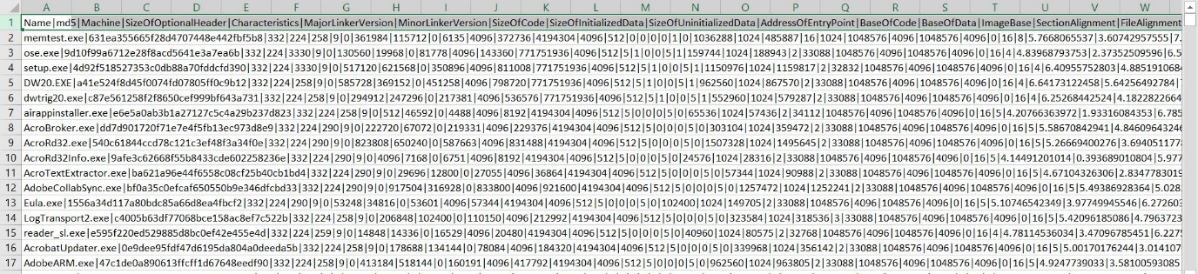
Handling Data
Our data includes file name and the rest is PE file headers and sections separated by ‘|’ respectively.

Slide 23
Feature selection
Extra Trees Classifier is a type of ensemble learning technique which aggregates the results of multiple de-correlated decision trees collected in a “forest” to output it’s classification result. In concept, it is very similar to a Random Forest Classifier and only differs from it in the manner of construction of the decision trees in the forest.
fsel = ske.ExtraTreesClassifier().fit(X, y)
model = SelectFromModel(fsel, prefit=True)
X_new = model.transform(X) # now features are only 9 :)
nb_features = X_new.shape[1] # will save value 13 as shape is (138047, 13) :}

Slide 24
Now converting in training and testing data in 20% range ! as total x is 138047 and testing is 138047*0.2=27610
X_train, X_test, y_train, y_test = model_selection.train_test_split(
X_new, y, test_size=0.2)
features = []
print('%i features identified as important:' %
nb_features) # as mentioned above
Sorting Important features for more accuracy
indices = np.argsort(fsel.feature_importances_)[::-1][:nb_features]
for f in range(nb_features):
print("%d. feature %s (%f)" % (
f + 1, data.columns[2+indices[f]], fsel.feature_importances_[indices[f]]))

Slide 25
Output
13 features identified as important:
1. feature DllCharacteristics (0.166928)
2. feature Characteristics (0.112034)
3. feature Machine (0.088879)
4. feature VersionInformationSize (0.075772)
5. feature Subsystem (0.066985)
6. feature ImageBase (0.051829)
7. feature SizeOfOptionalHeader (0.051030)
8. feature MajorSubsystemVersion (0.049418)
9. feature SectionsMaxEntropy (0.048206)
10. feature ResourcesMaxEntropy (0.035509)
11. feature ResourcesMinEntropy (0.033891)
12. feature MajorOperatingSystemVersion (0.023647)
13. feature SectionsMinEntropy (0.020279)
Important Features-
['Machine', 'SizeOfOptionalHeader', 'Characteristics', 'ImageBase', 'MajorOperatingSystemVersion', 'MajorSubsystemVersion', 'Subsystem', 'DllCharacteristics', 'SectionsMinEntropy', 'SectionsMaxEntropy', 'ResourcesMinEntropy', 'ResourcesMaxEntropy', 'VersionInformationSize']

Slide 26
Algorithm training
We create a dictionary key = Name of algorithm , Value= Algorithm classifier code and loop over it
algorithms = { }
Random Forest
"RandomForest": ske.RandomForestClassifier(n_estimators=50),
The max_depth parameter denotes maximum depth of the tree. In case, of random forest, these ensemble classifiers are the randomly created decision trees. Each decision tree is a single classifier and the target prediction is based on the majority voting method.

Slide 27
Gradient Boosting and AdaBoost
"GradientBoosting": ske.GradientBoostingClassifier(n_estimators=50),
"AdaBoost": ske.AdaBoostClassifier(n_estimators=100),
Ada mean Adaptive Both are boosting algorithms which means that they convert a set of weak learners into a single strong learner. Theyboth initialize a strong learner (usually a decision tree) and iteratively create a weak learner that is added to the strong learner. They differ on how they create the weak learners during the iterative process.

Slide 28
Bayes Theorem
GNB": GaussianNB()
Bayes theorem is based on conditional probability. The conditional probability helps us calculating the probability that something will happen
Decision Trees
"DecisionTree": tree.DecisionTreeClassifier(max_depth=10)

Slide 29
Output-
Now testing algorithms
RandomForest : 99.406012 %
GradientBoosting : 98.804781 %
AdaBoost : 98.652662 %
GNB : 70.398406 %
DecisionTree : 99.058312 %
Winner algorithm is RandomForest with a 99.406012 % success
Saving algorithm and feature list in classifier directory...
Saved
[[19372 94]
[ 53 8091]]
False positive rate : 0.488759 %
False negative rate : 0.844243 %

Slide 30
Confusion Matrix
A confusion matrix, also known as an error matrix, is a specific table layout that allows visualization of the performance of an algorithm, typically a supervised learning.
[[19372 94]
[ 53 8091]]
Saving the features list
Save the algorithm and the feature list for later predictions
Persist an arbitrary Python object into one file.
joblib.dump(algorithms[winner], 'classifier/classifier.pkl')
open('classifier/features.pkl', 'wb').write(pickle.dumps(features))
joblib works especially well with NumPy arrays which are used by sklearn so depending on the classifier type you use you might
Have performance and size benefits using joblib.Otherwise pickle does work correctly so saving a trained classifier and loadingit again will produce the same results no matter which of the serialization libraries you use

Slide 31
Flask Scripts
Parent Script
In order to test Flask installation, type the following code in the editor as checker.py
from flask import Flask
@app.route('/')
def home():
return render_template('index.html')
if __name__ == '__main__’:
app.run(debug=True)

Slide 32
Analysing alien file
Here, we upload the alien PE file and run malware analysis on it.
The result is displayed on ‘result.html’ template
@app.route('/uploader', methods=['GET', 'POST'])
def upload_file():
if request.method == 'POST':
f = request.files['file’]
f.save(secure_filename(f.filename))
Now loading previously saved features for comparing and analysing,
clf = joblib.load(os.path.join(os.path.dirname(
os.path.realpath(__file__)), 'classifier/classifier.pkl'))
features = pickle.loads(open(os.path.join(os.path.dirname(
os.path.realpath(__file__)), 'classifier/features.pkl'), 'rb').read()
data = extract_infos(tweet) pe_features = list(map(lambda x: data[x], features))
res = clf.predict([pe_features])[0]
return render_template('result.html', prediction=['legitimate', 'malicious'][res])

Slide 33
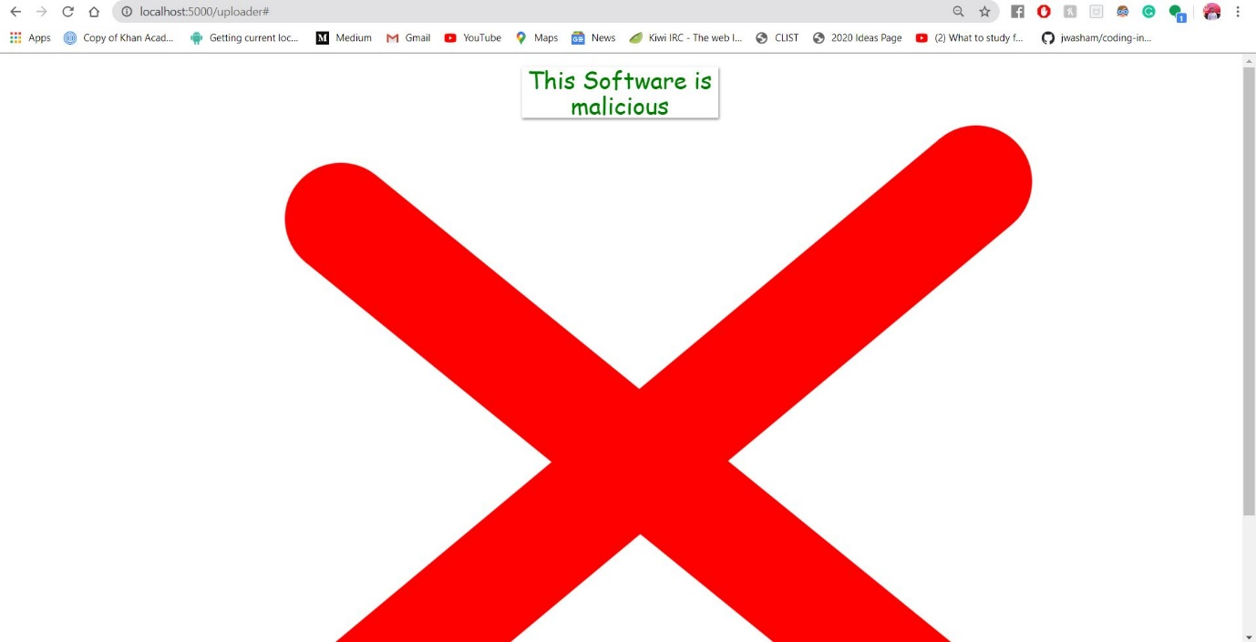
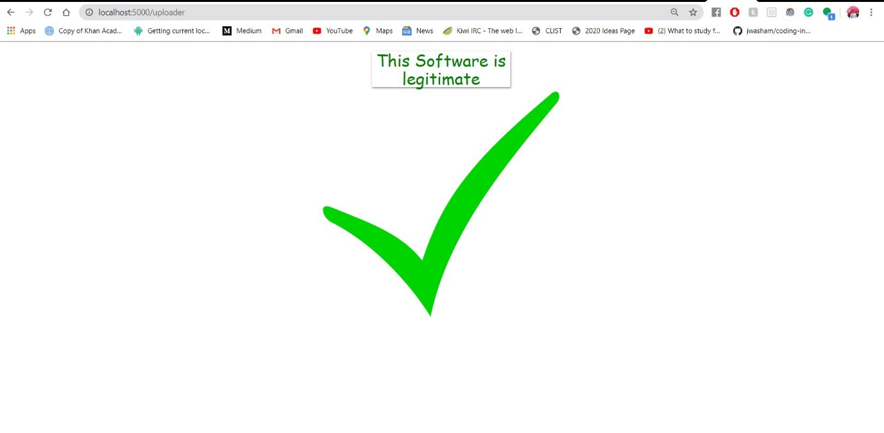
returning ‘result.html’ to display the result of analysis

